Slide 1

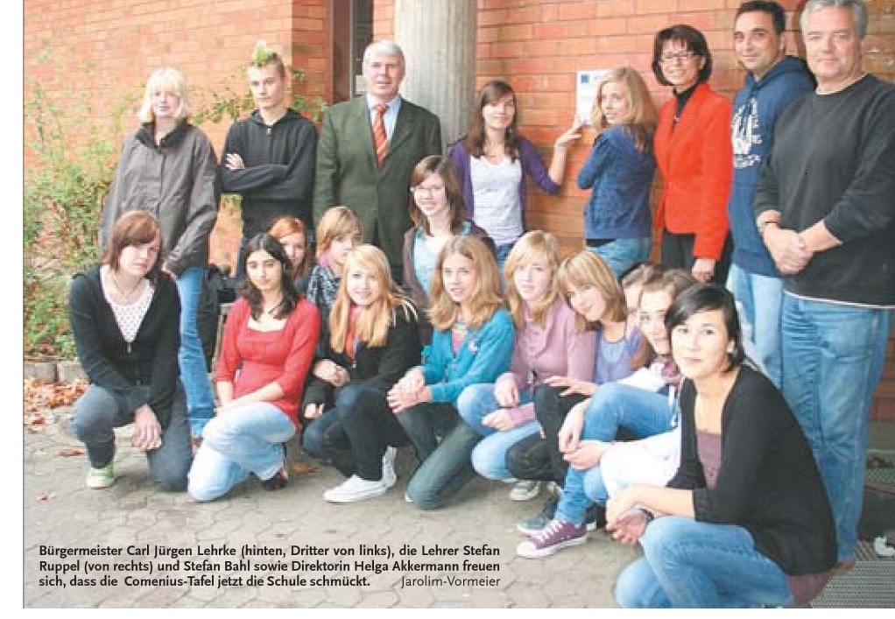
Educating in simplicity and solidarity Comenius Project 2009 – 2011 KGS Sehnde

Slide 2
COMENIUS…
is an European program for school education
supports the mobility of students, student teachers and teachers
encourages learning of modern foreign languages
encourages regional partnerships in schools between regions and communities

Slide 3






The Countries
Germany
Spain
Greece
Italy
Turkey
Poland

Slide 4
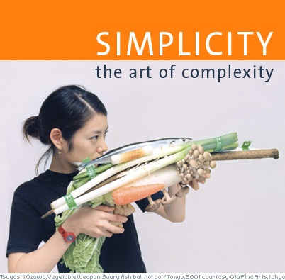
The first year of the project - Simplicity-

Slide 5
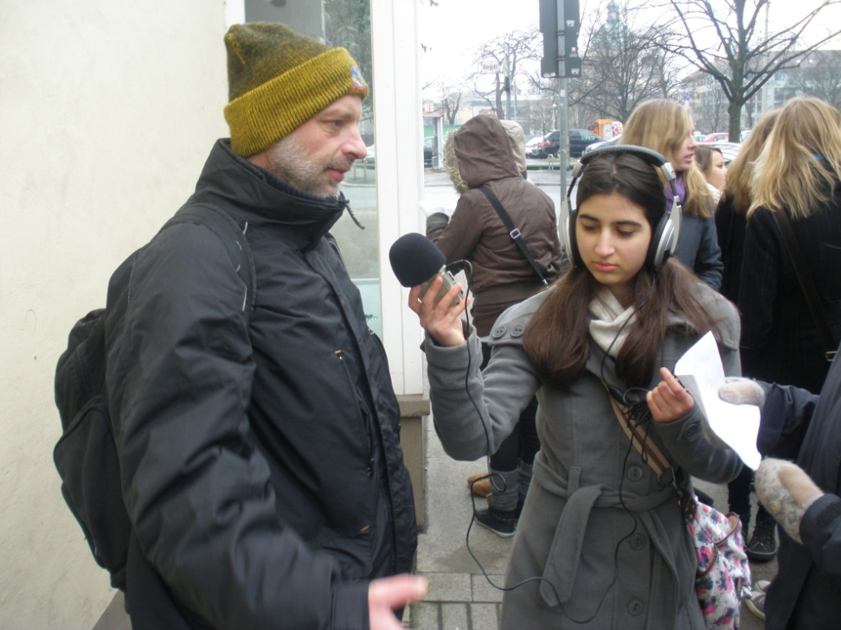
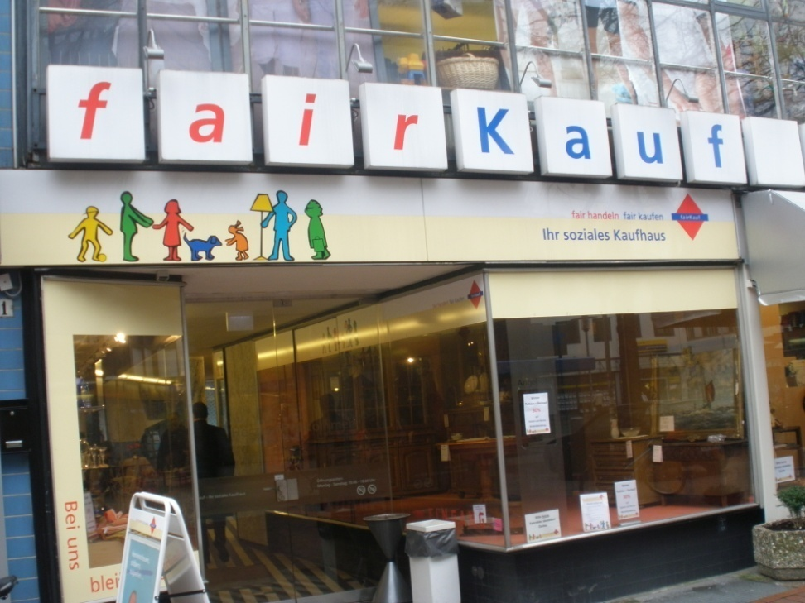
The second year: Solidarity

Slide 6

The Logo
Pupils designed their own logo for the project

Slide 7

Literature
Pupils started a project on creative writing – prose or poems on the topic simplicity and solidarity
Pupils took part in the literature competition of the city of Burgdorf

Slide 8

Survey in Primary Schools
Pupils started a survey on TV watching habits and analyzed the results with the help of the Grafstat-Program

Slide 9
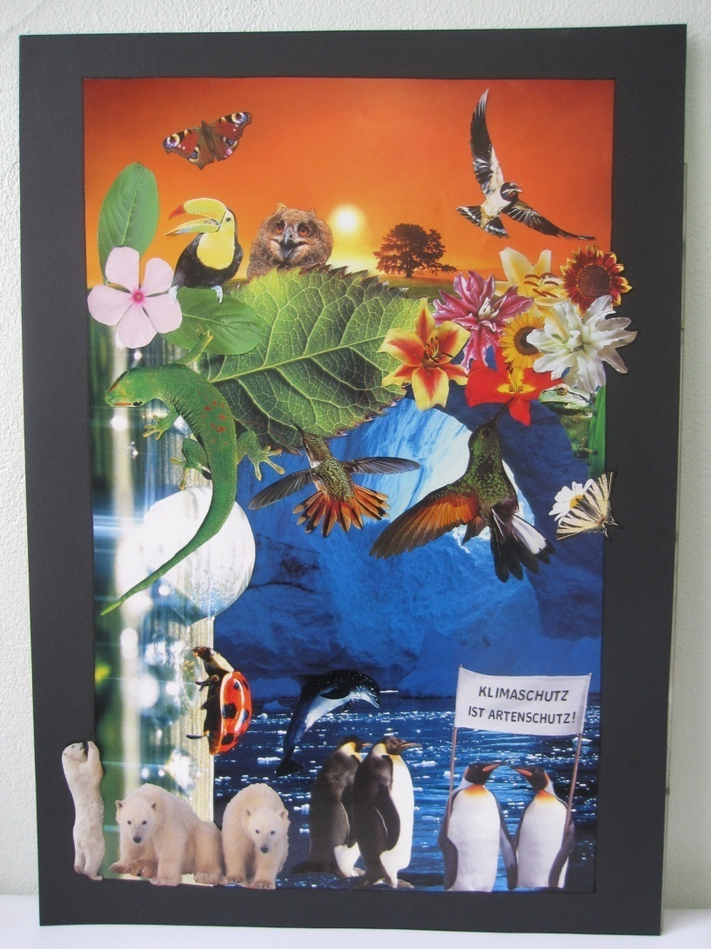
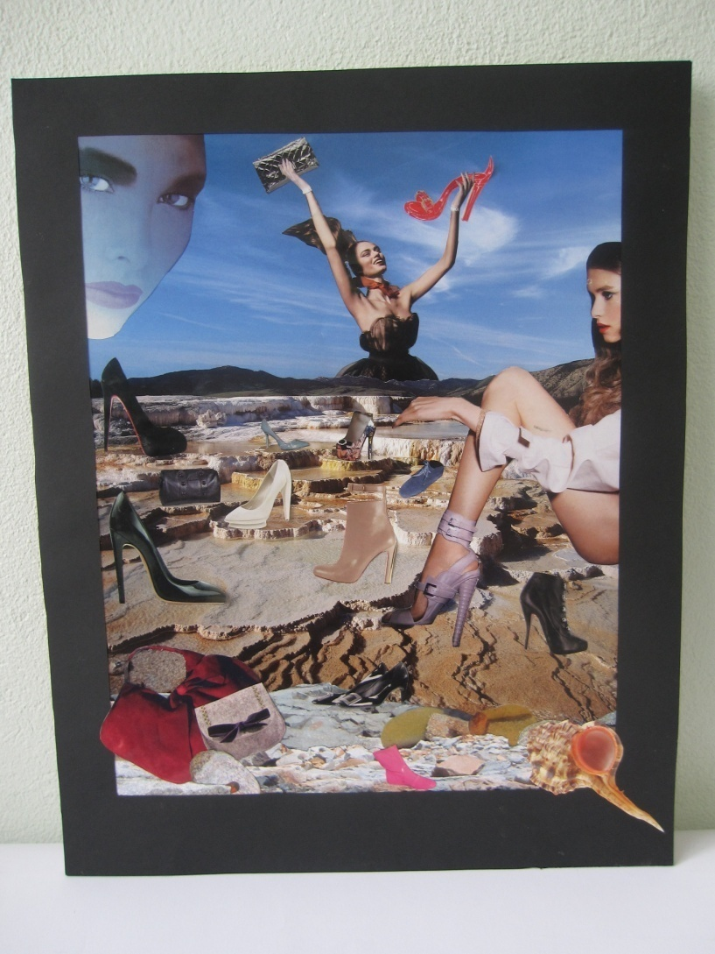
Activity Week 2010: Simplicity

Slide 10
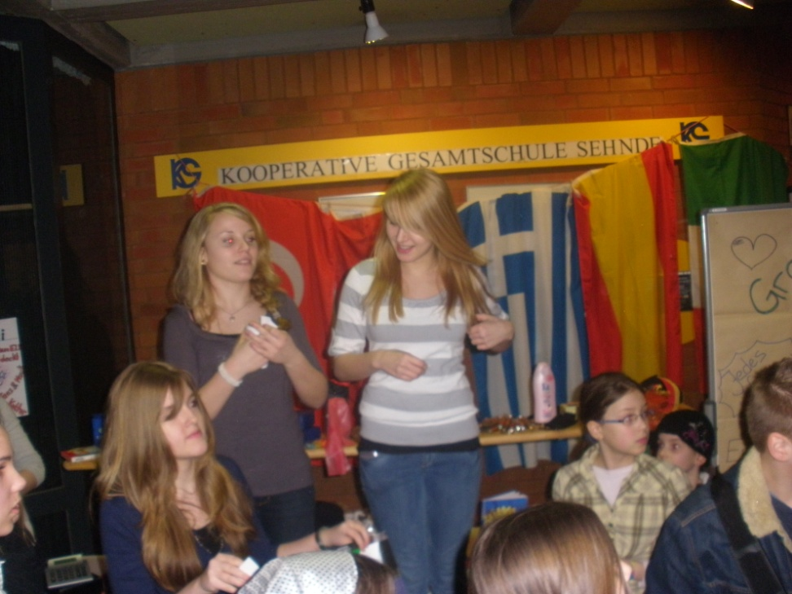
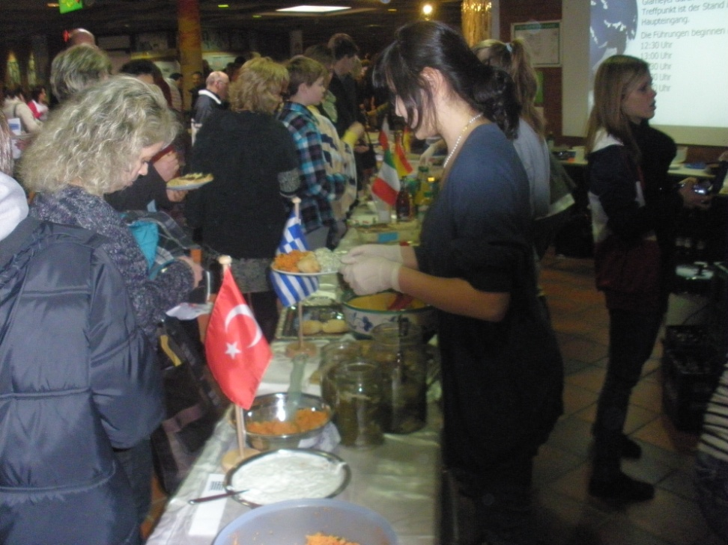
Activity Week 2011: Solidarity

Slide 11
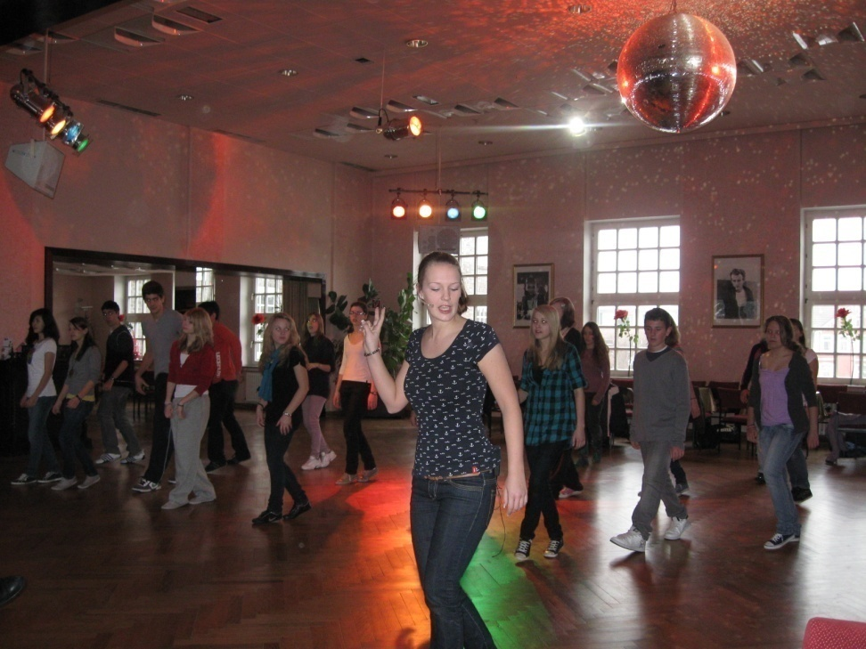
Dancing Workshop
We put on a dancing performance supported by a professionell dancing teacher

Slide 12
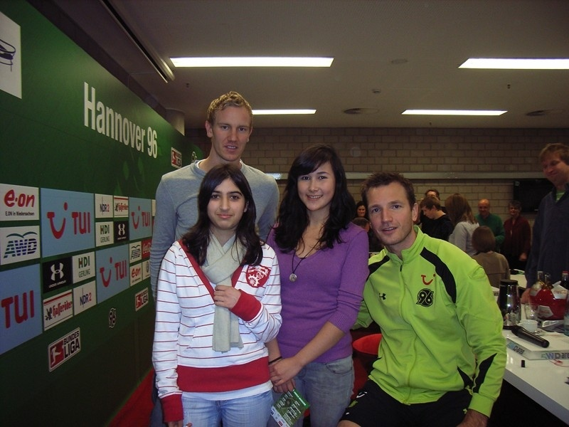
Hannover 96
We accompanied and filmed two football players for one day in order to reflect and to discuss consuming habits

Slide 13

Alternative Tourist Guide
We created a critical tourist guide for Hanover in cooperation with the Organisation „…für Demokratie Courage zeigen“

Slide 14
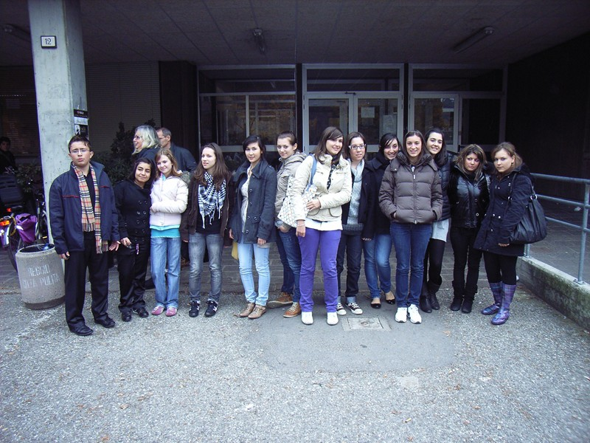
Italy 2009

Slide 15
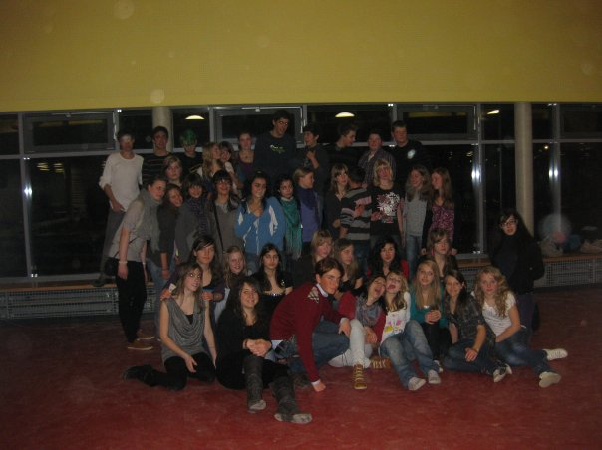
Germany 2010

Slide 16
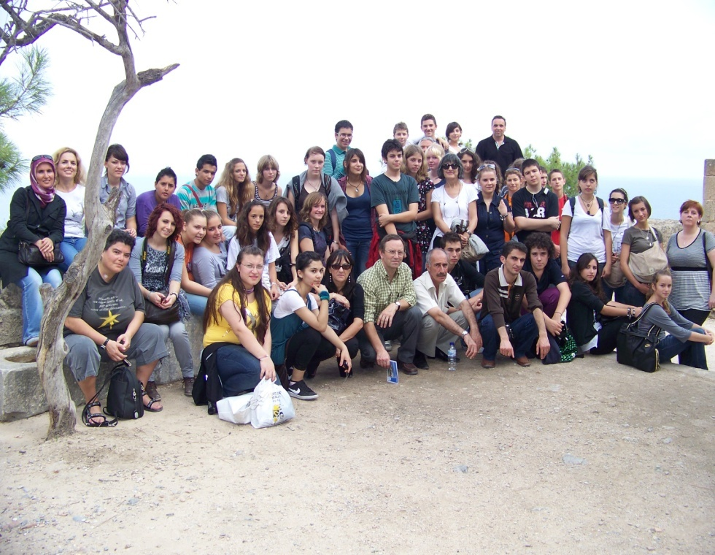
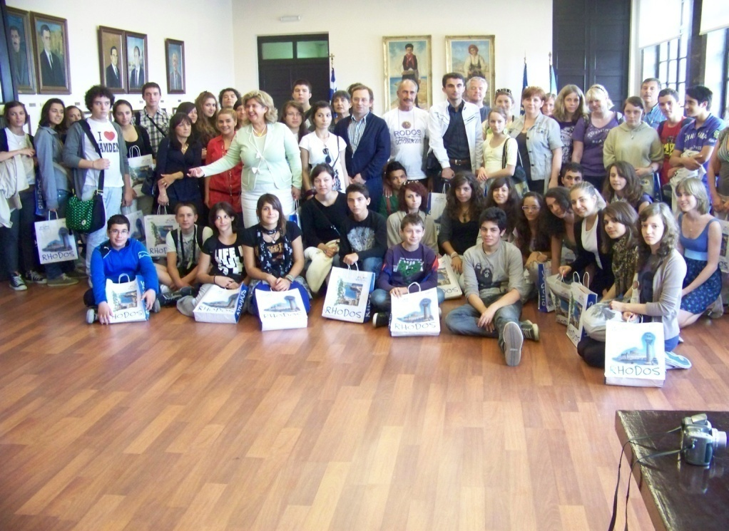
Greece 2010

Slide 17
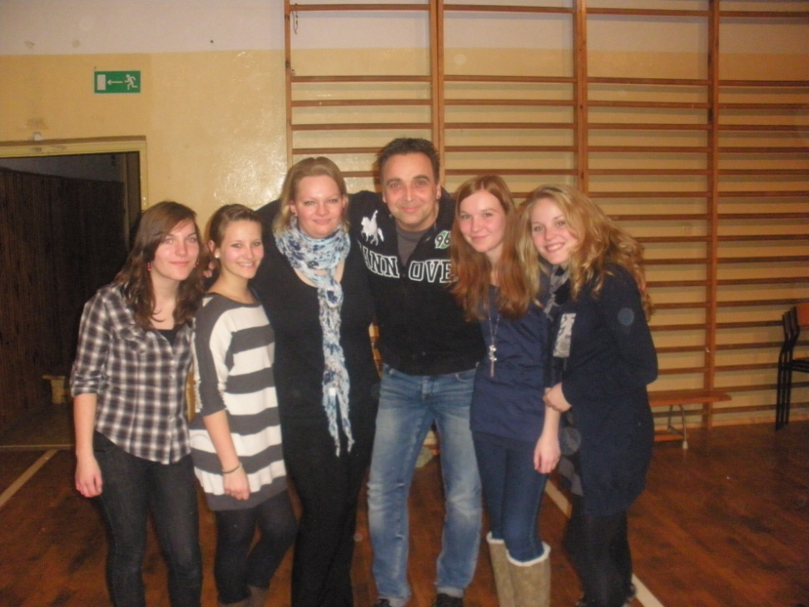
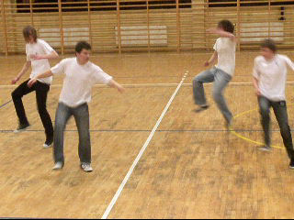
Poland 2011

Slide 18
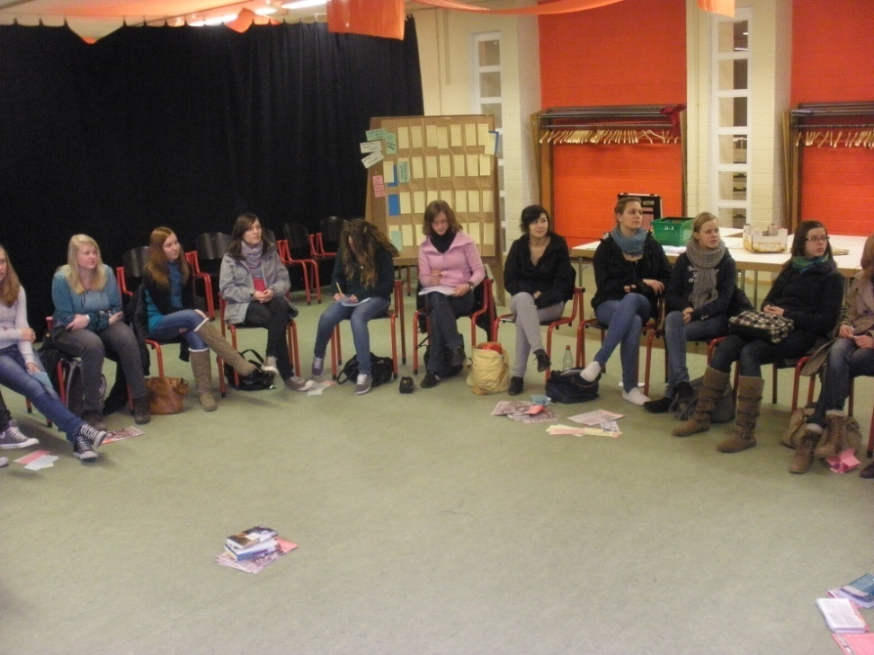
Trip to Barcelona
Finally we will organize a trip to Barcelona for 8 days to complete the JuLeiCa-Education

